Slide 1
Credit Card Approval Prediction
Guozhao Tian
444173

Slide 2
Problem description
Background:
Credit card approval is a critical process for financial institutions to manage risk and make informed lending decisions. The approval or denial of credit cards is influenced by various factors such as applicant demographics, financial history, and credit behavior. Predicting credit card approval accurately is crucial for maintaining a healthy credit portfolio and avoiding potential losses.
Objective:
The primary objective of this project is to predict credit card approval for applicants based on historical data and relevant features. By leveraging machine learning models, my aim to enhance the accuracy of credit card approval predictions and identify key determinants influencing the decision.
Problem Description:
Credit card approval prediction involves assessing the likelihood of an applicant being approved for a credit card based on their individual and financial characteristics. This predictive modeling task is crucial for financial institutions to streamline the approval process and minimize the risk of defaults.

Slide 3
Dataset description
Columns description
Applicant_ID - Client number
Applicant_Gender - Gender
Owned_Car - Is there a car
Owned_Realty - Is there a property
Total_Children - Number of children
Total_Income - Annual income
Income_Type - Income category
Education_Type - Education level
Family_Status - Marital status
Housing_Type - Way of living
Owned_Mobile_Phone - Is there a mobile phone
Owned_Work_Phone - Is there a work phone
Owned_Phone - Is there a phone
Owned_Email - Is there an email
Job_Title - Occupation
Total_Family_Members - Family size
Applicant_Age - Age
Years_of_Working - Working years
Total_Bad_Debt - Number of bad debts
Total_Good_Debt - Number of good debts
Status - 0 means not approved, 1 means approved.
The dataset for this project is sourced from Kaggle: Credit Card Approval Dataset. The dataset includes various features such as income, age, employment details, and other relevant information about credit card applicants.
Credit Card Dataset Originally from Seanny (@rikdifos)
This dataset is merged, cleaned, and transformed using Pentaho Data Integration. Full explanation is available on GitHub (https://github.com/caesarmario/etl-credit-card-dataset-using-pentaho)

Slide 4
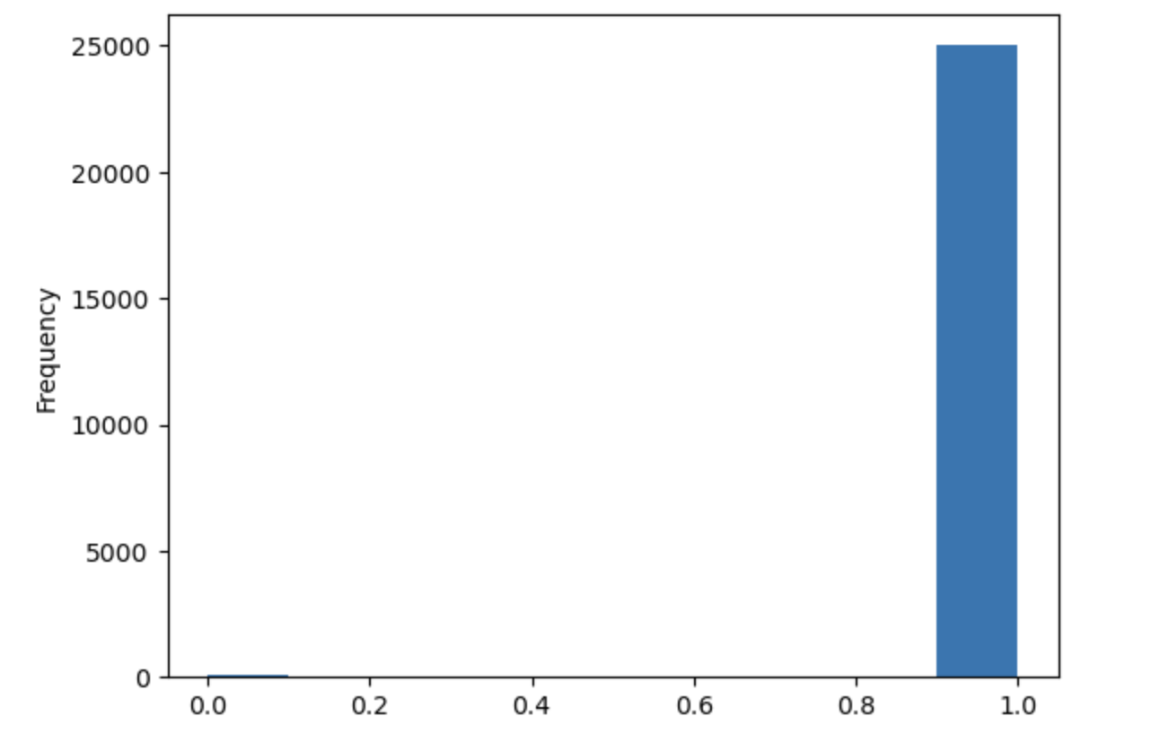
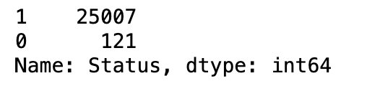
Data Exploration and Preprocessing
Investigate STATUS value distribution
STATUS is a dependent data (label) in data. 0 means not approved, 1 means approved.
We can see that in all the data, most people are approved for credit cards, and only a handful of people are not.
There were a total of 25,128 applicants, and only 121 were not approved for credit card approval. Generally speaking, credit card approval is relatively easy to pass in my set of data.

Slide 5
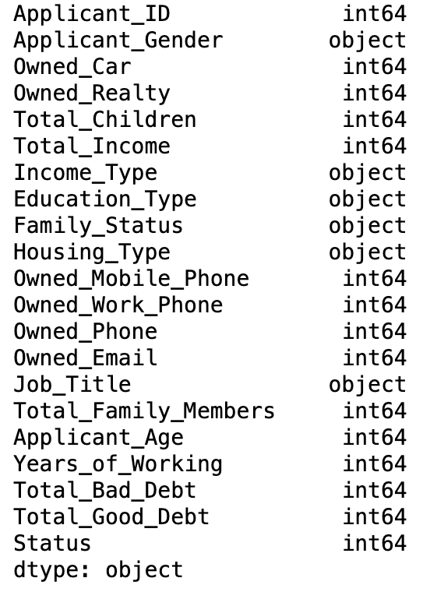
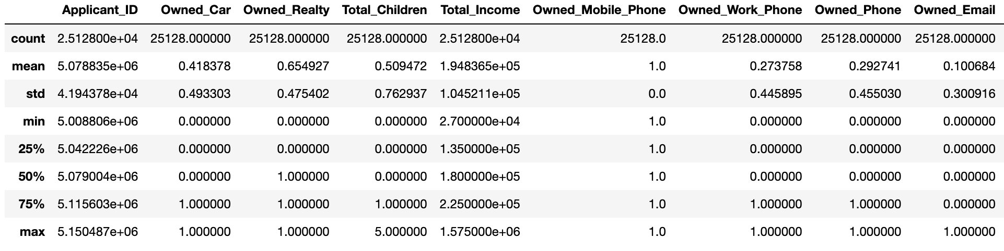
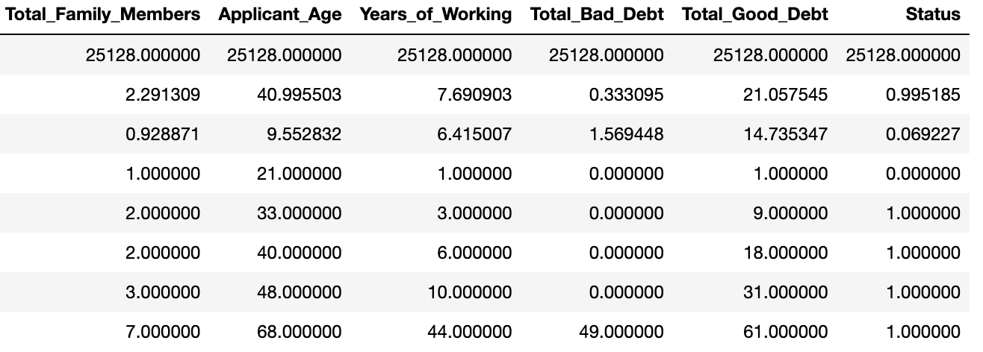
Investigate Data
I investigated the research data types and investigated what might be invalid data. From the table I see no particularly unusual data.

Slide 6
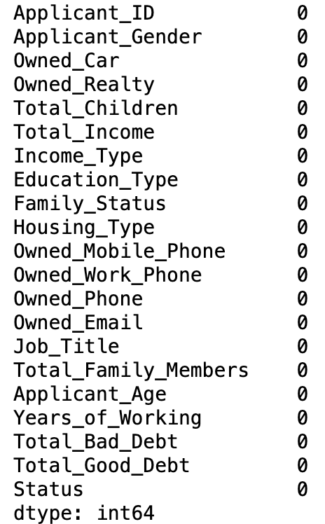
Handle missing values
I checked if there are missing values.
The results show that there are no missing values.

Slide 7
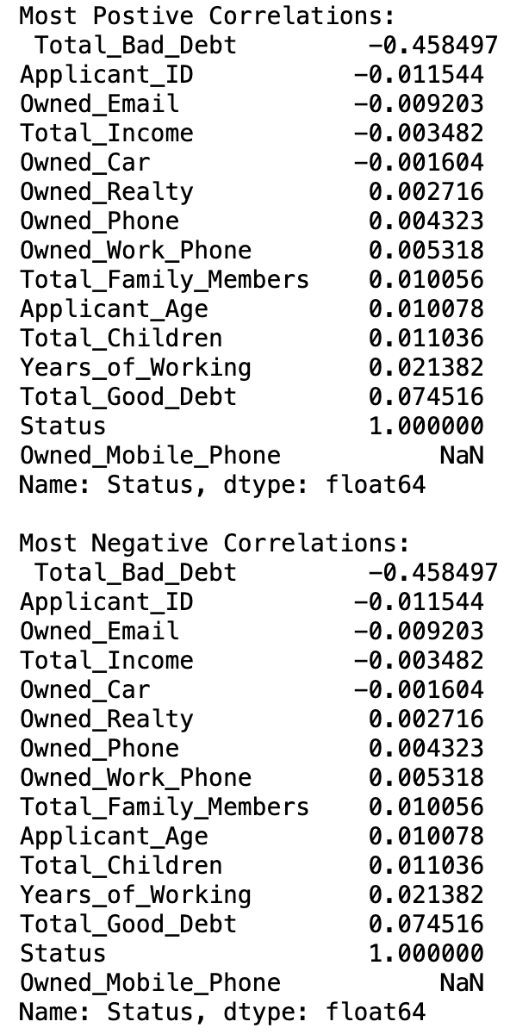
Feature Selection
I selected the 15 most relevant values and conducted correlation analysis.
It can be seen from the correlation in the table that the only feature with a relatively high correlation with the target (greater than 0.05) is Total_Good_Debt. This feature indicates that good debt is positively related to credit card approval. The more good debt you have, the higher your chances of getting approved for a credit card (1).
Bad debt is also negatively correlated with credit card approval.

Slide 8
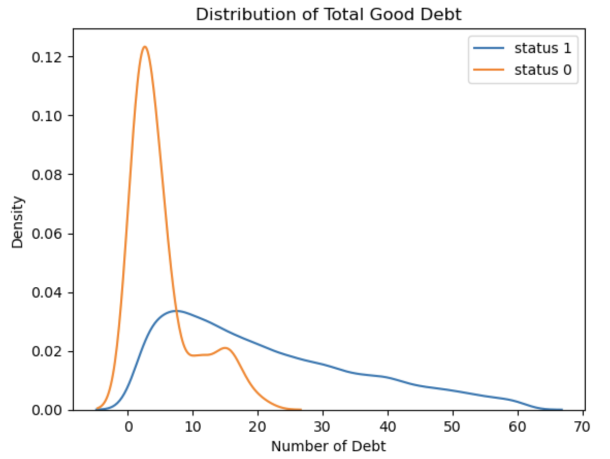
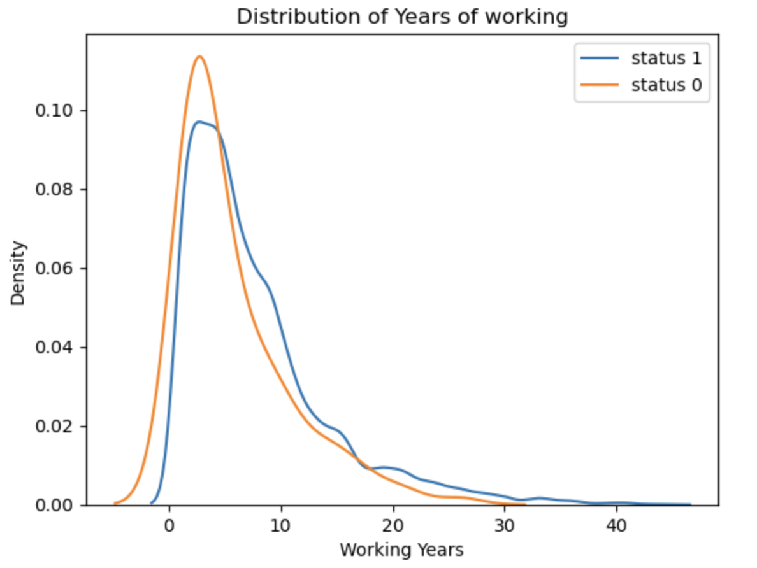
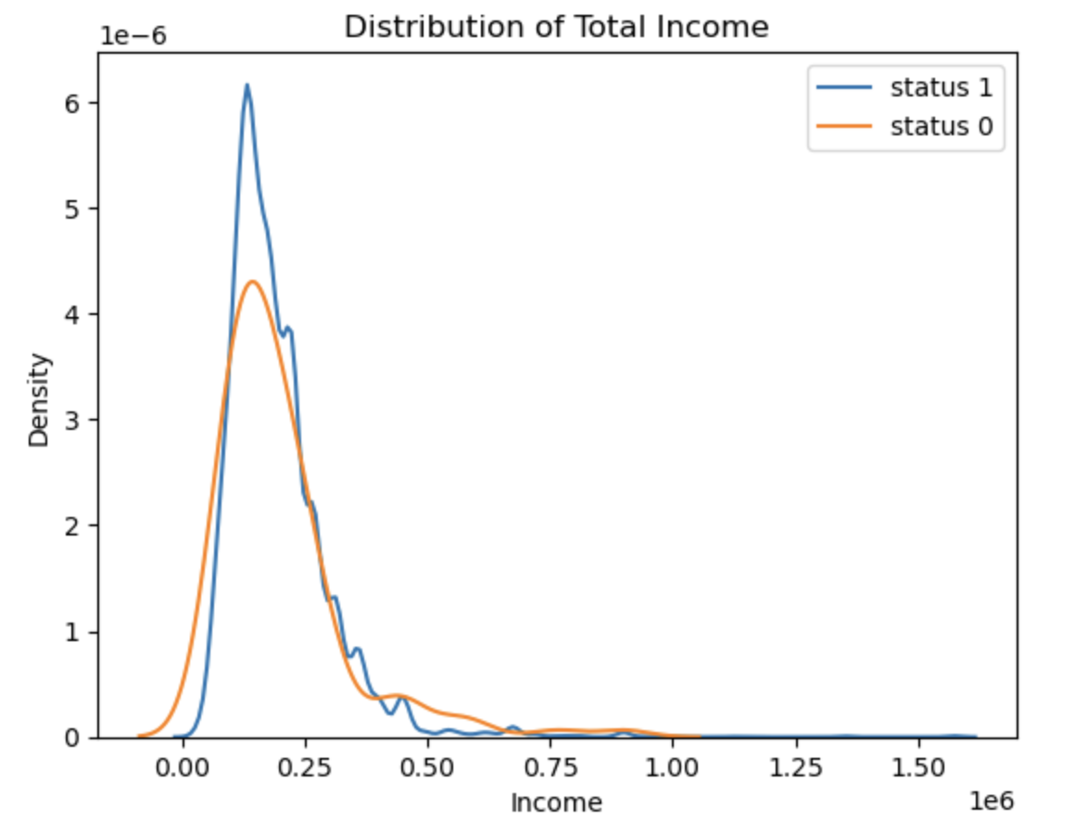
Investigate numeric-typed attribute distribution
From the Distribution of Total Good Debt we can see that the greater the number of good debts, the greater the chance of being approved for a credit card.
The number of good debts that have not been approved by credit cards is mostly concentrated in 2 times.
The distributions of years of working and total income are very similar for credit card approvals and non-approvals.

Slide 9
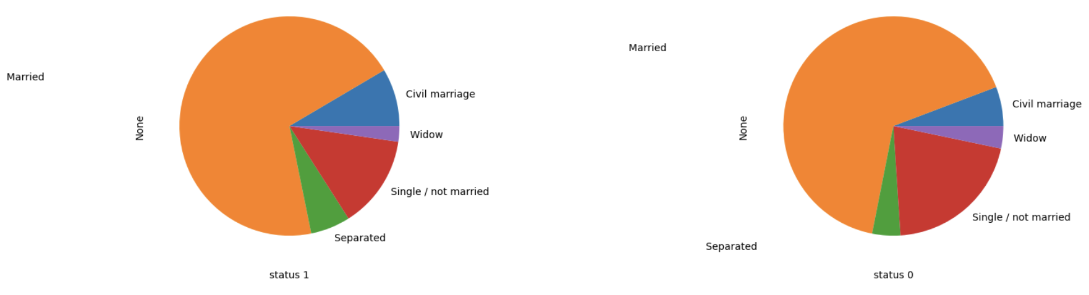
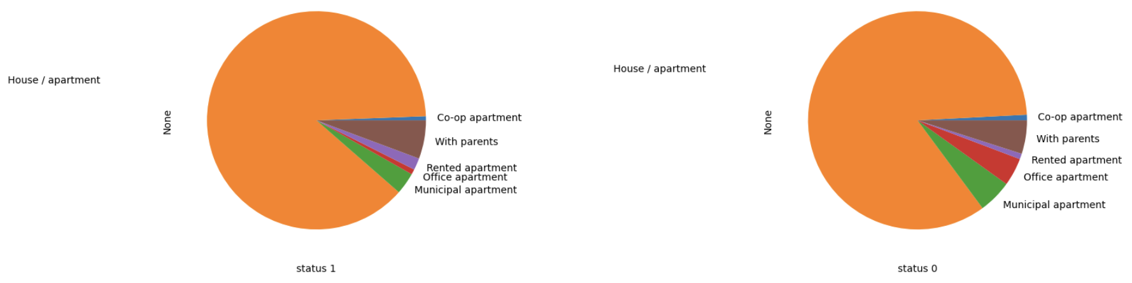
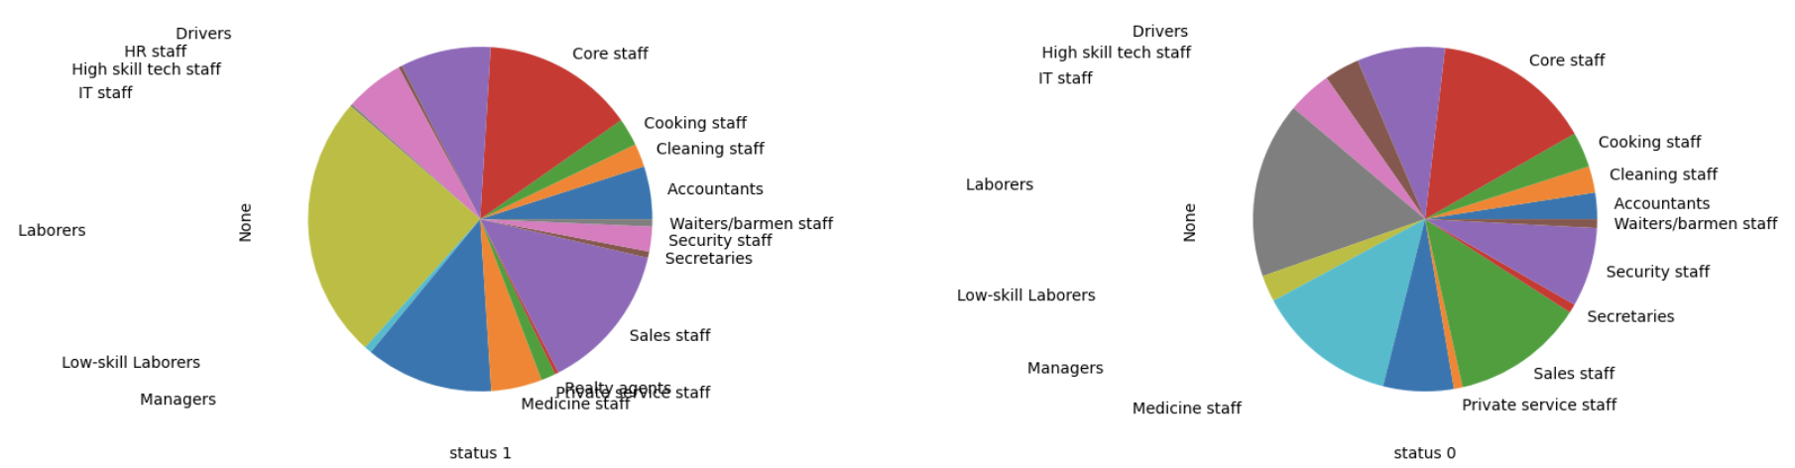
Investigate object-typed attribute distribution
Correlation Analysis can only analyze attributes with numeric type. Meanwhile, object-type data may could be a good feature too.
So I want to visualize the distribution of some object-typed attribute on Status=0 and Status=1.
Family status
Housing type
Job title

Slide 10
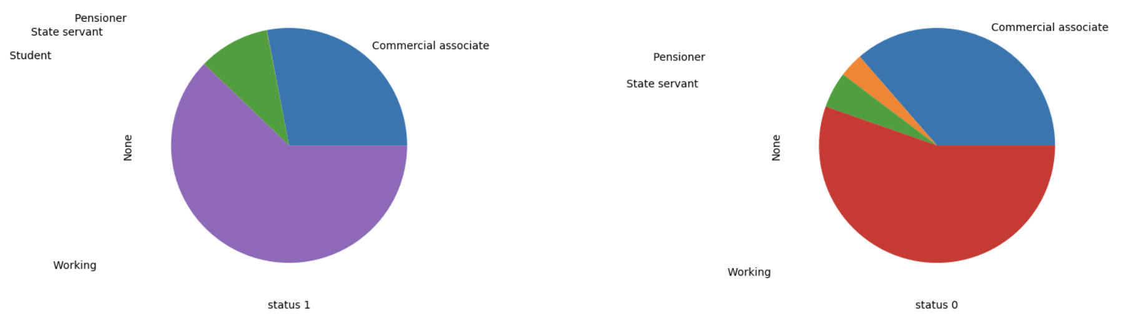
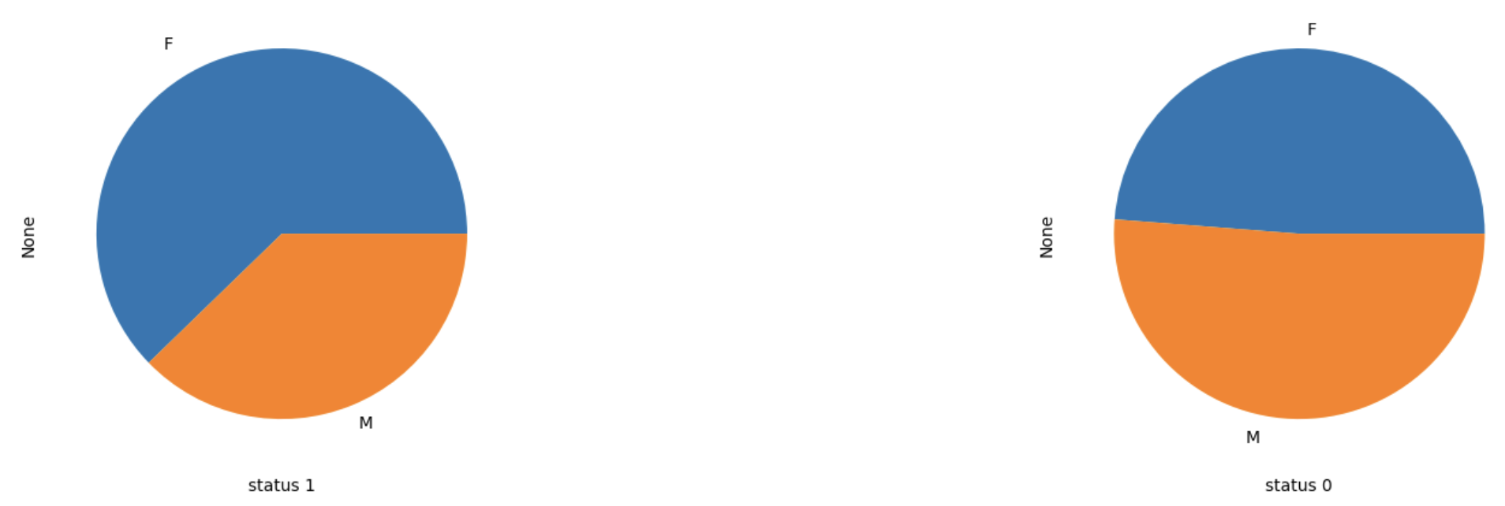
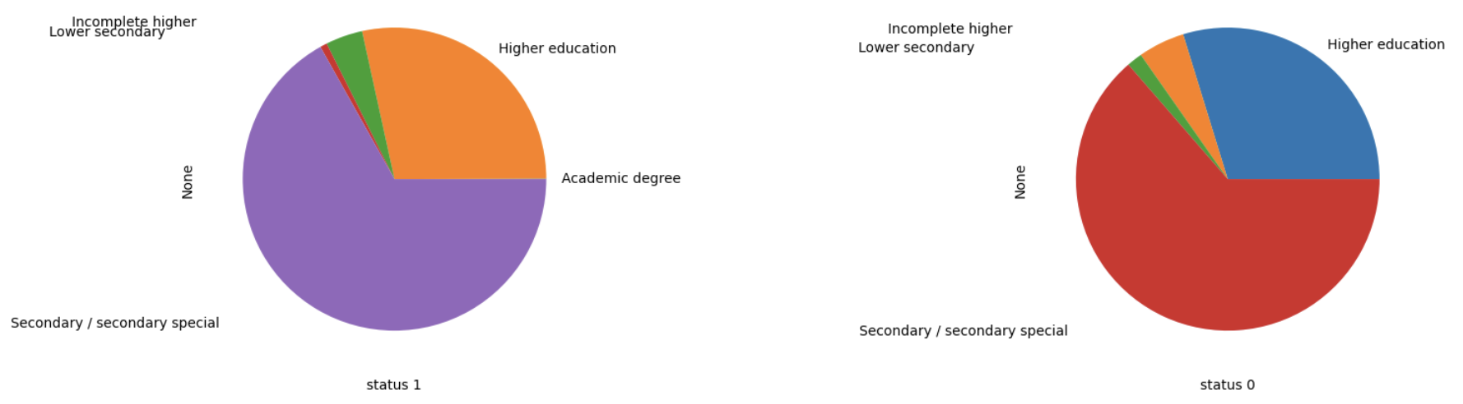
Select the Features
From the distribution above. There are some attributes that does not have significant difference in distribution between STATUS=0 and STATUS=1, but some have significant difference.
Intuitively the more diverse the distribution between STATUS=0 and STATUS=1 more likely the attributes will be useful as a feature. Some of them are:
1. Education_Type
2. Income_Type
3. Applicant_Gender
Income type
Applicant Gender
Education type

Slide 11
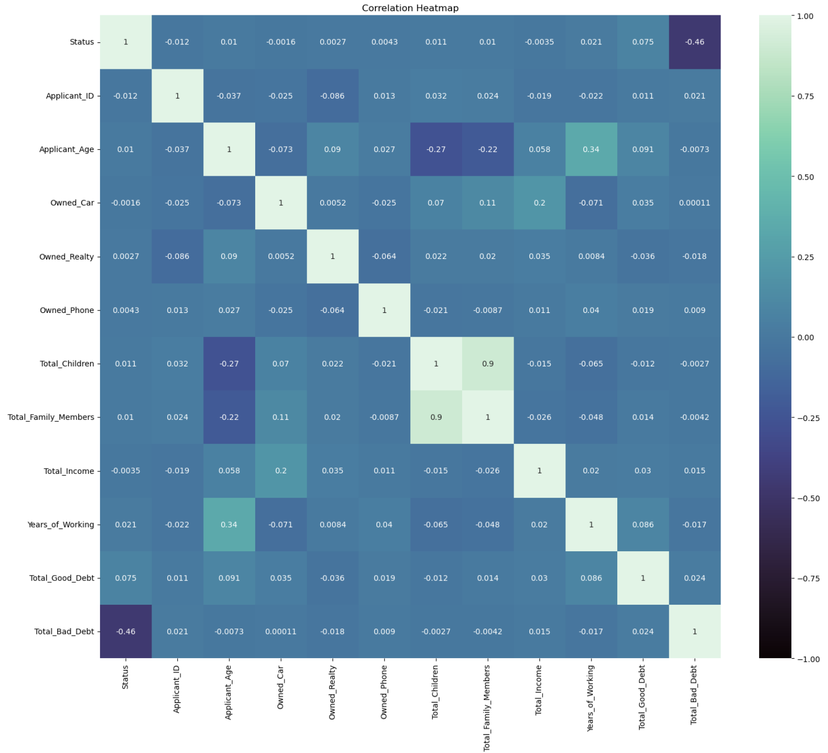
Correlation Heatmap
The intensity of the color represents the strength of the correlation. Darker colors indicate a stronger correlation.
From the correlation heatmap we can see that the strongest correlation is: Total Bad Debt.
Therefore, Total Bad Debt is a key factor affecting credit card approval.

Slide 12
Feature Transformation
1. Transform Ordinal Object Typed Attribute
Object-type attribute that has value that can be ranked is Education_Type. That attribute can be ranked and transformed like this:
Lower secondary = 0
Secondary / secondary special = 1
Incomplete higher = 2
Higher education = 3
Academic degree = 4
2. Transform Categorical Object Typed Attribute
Here I transform the categoric object attributes: ‘Applicant_Gender’ and ‘Income_type’.
The next steps are:
1. Split features and labels
2. Using SMOTE to handle imbalance data
3. Scale the data using Standard Scaler
4. Split Train and Test (training set 70%; test set 30%)

Slide 13
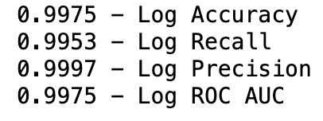
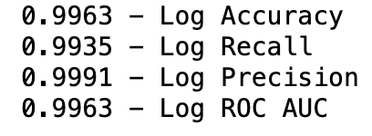
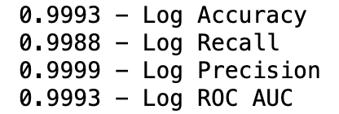
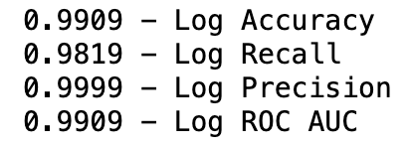
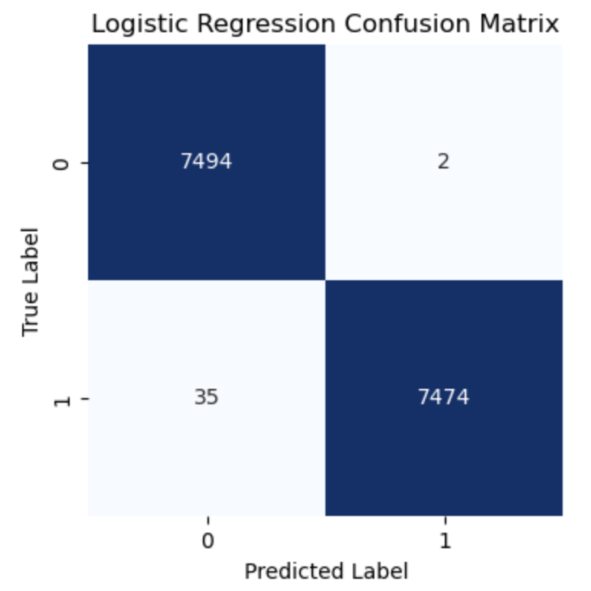

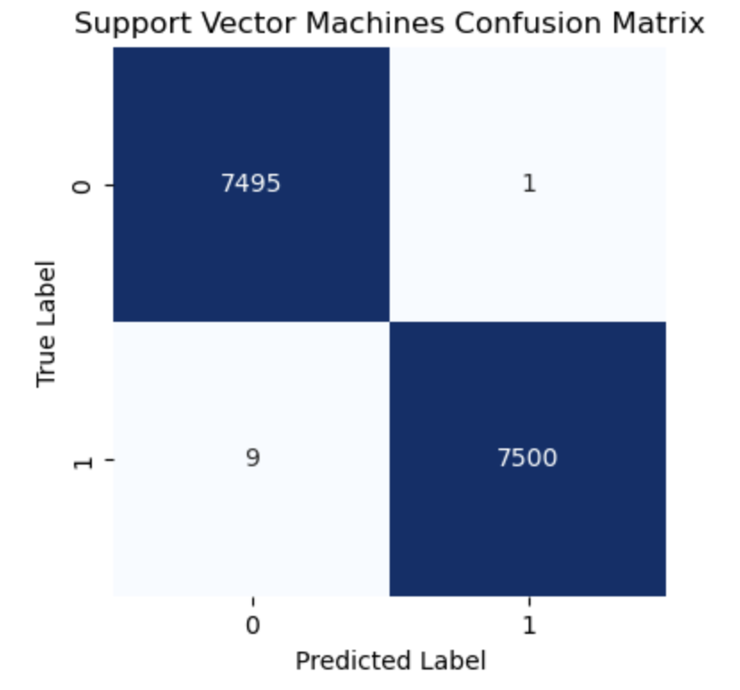
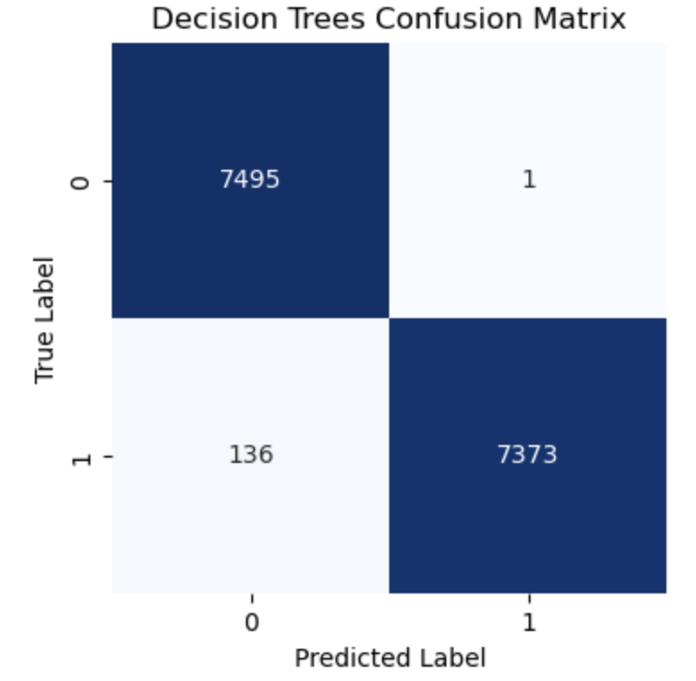
Model Building
All four models achieved particularly high scores.
The extremely high ROC AUC scores indicate that these models effectively balance the true positive and false positive rates, resulting in robust classification performance.
Logistic Regression Model
KNN
SVM
Decision trees

Slide 14
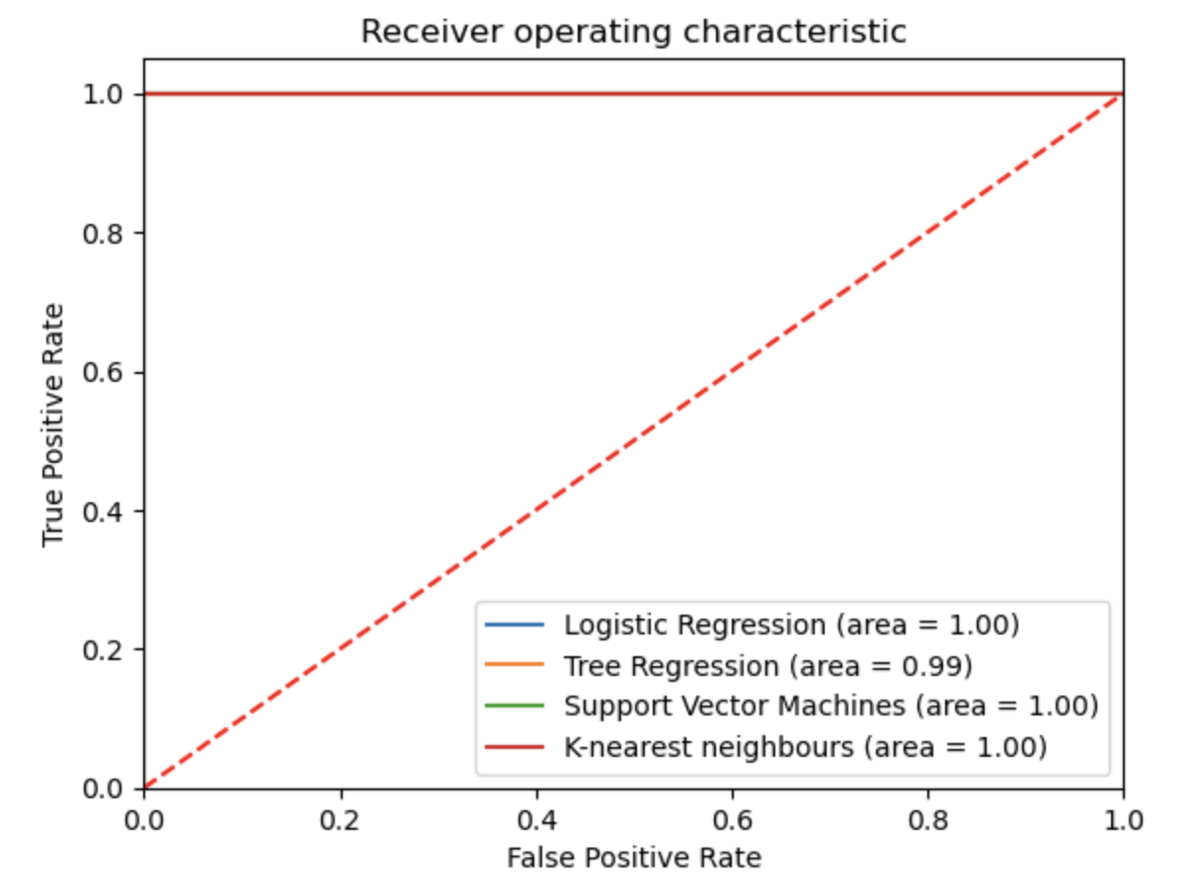
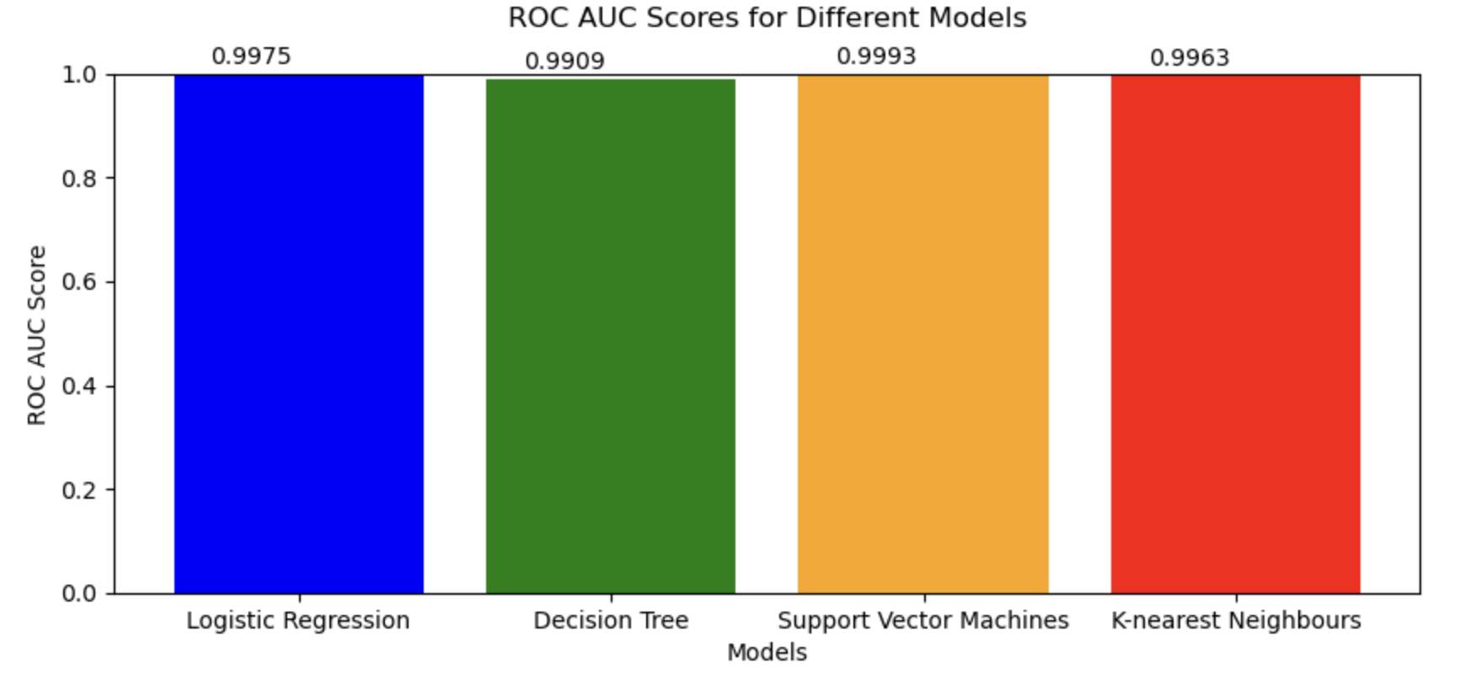
Final comparison and summary
Visualization of the results
In this project I am using binary classification, so I will focus on explaining and comparing the ROC and AUC values of the model.
A higher ROC AUC score generally indicates better discrimination ability. In my case, all models have achieved high ROC AUC scores, with SVM achieving the highest score of 0.9993. evaluations.
Interesting observation:
All people who were disapproved for credit cards had more bad debt than good debt.

Slide 15
Thank you for listening

